Slide 1


Ensuring Information Security While Employees Work from Home Group Assignment
IE3072-Information Security and Policy Management
IT20238926-N.M.P. Nawarathne
IT20045258-Abeywickrama J.A.S.T
IT20028046-S.B.M.B.S.A Gunathilaka
IT20166656-Seneviratne S.M.N.H.
IT19108100-Herath H.M.C.S.B

Slide 2
Introduction
Due to pandemic most workers are now working from home.
Most companies have not done remote work before this [1].
Cyber-attacks have risen sharply during pandemic [2].
Most employees do not know good security practices [3].
Cyber-attacks are a leading cause of bankruptcy [4].

Slide 3
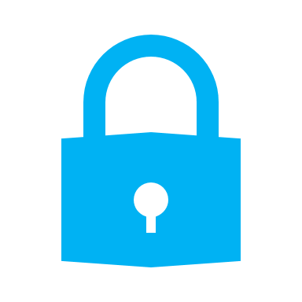
Introduction continued...
Five areas where work from home security can be improved, and their issues and solutions.
Securing Employee accounts
Securing employee home network.
Securing Employee personal devices.
Employee understanding of cyber security.
Employee physical security at home.

Slide 4
Securing Employee accounts
Businesses are increasingly using online collaboration tools during pandemic.
Need to keep these accounts secure.
Factors which effect account security:
Weak passwords
Reusing passwords
Using same email for work and personal use.
Using insecure services

Slide 5
Securing Employee accounts
Continued...
Above issues can be solved by:
Using a unique password for each account.
Using multiple emails.
Using a password manager
Vetting online services
Using multi-factor authentication

Slide 6
Securing Employee accounts
Continued...
Recommendations to businesses:
Policy to mandate employee’s use unique passwords for all the accounts that are related to work.
Policy to mandate employee passwords must be of a certain length and contain a minimum number of special characters to ensure that the password is strong.
Policy to mandate employees do not use their work email address to anything not related to work.
Policy to mandate the use of a password manager.
Policy to mandate the use of multifactor authentication for work related accounts.
Policy to mandate that the organization provides their employees with a vetted list of safe password managers.
Policy to regularly vet online/ cloud collaboration tools and provide employees with a list of services that are considered secure.
Policy to mandate those employees only use online services vetted by the organization for work related purposes.

Slide 7
Securing employee home network

Slide 8
Securing employee Personal Devices

Slide 9
Employee Understanding of Cyber Security
Cyber Security is important because it protects all categories of data from theft and damage.
A personal Cyberattack on an employee can create a huge burden for the organization.
What should do for prevent such a scenario?
Educate Employees About Cyberstalking Preventong Physhing Attacks EducateEmployees On Social Engineering and Scams Securing Collaboration Apps Implement Password Safety Guidlines

Slide 10
Employee Physical Security at Home
What is Physical Security ?
Protection against unplanned events or acts that could cause damage or loss to people, equipment, data, software, physical assets, and property
Why Physical Security is important in WFH ?
IT20166656-Seneviratne S.M.N.H.

Slide 11
Employee Physical Security at Home
Common Work From Home Physical Security Risks
Using Personal Devices for Work
Physical Backups
Dumpster Diving
Shoulder Surfing
IT20166656-Seneviratne S.M.N.H.

Slide 12
Employee Physical Security at Home
Using Personal Devices for Work
Additionally, employees who use their own devices while working from home are free to access any website they like and install any applications or software packages that a company may normally restrict for security reasons, that making them a prime target for malicious activity and hackers.
IT20166656-Seneviratne S.M.N.H.

Slide 13
Employee Physical Security at Home
Physical Backups
Physical backups are the more traditional method.
Hard to maintain with workload.
Keeping a backup of your data on a separate hard drive or portable hard drive may be a risk
If portable storage devices were lost or steal , they would be able to miss use the data.
IT20166656-Seneviratne S.M.N.H.

Slide 14
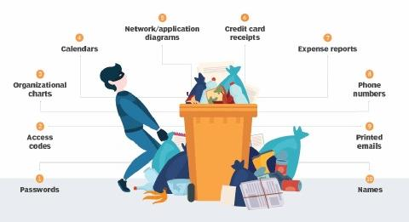
Employee Physical Security at Home
Dumpster Diving
Digging through trash at corporations in search of sensitive data.
IT20166656-Seneviratne S.M.N.H.

Slide 15
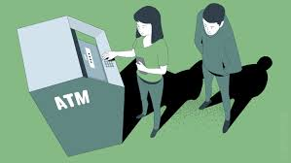
Employee Physical Security at Home
Shoulder Surfing
A situation where the attacker can physically view the device screen and keypad to obtain personal information.
IT20166656-Seneviratne S.M.N.H.

Slide 16
Employee Physical Security at Home
Common rules and solutions to overcome.
Employee IT Support and Cyber Security Training
Turn on Remote Wiping
Utilize Two Separate Devices for Work and Personal Use
Working remotely is not the same as working from home
Ensure the health and wellbeing of your team
Surveillance cameras
Use cloud base backups
IT20166656-Seneviratne S.M.N.H.

Slide 17
References
[1] Wang, Bin, et al. “Achieving effective remote working during the COVID-19 pandemic: A work design perspective.” Applied psychology 70.1 (2021): 16-59.
[2] Interpol. Cybercrime: Covid-19 impact. Aug 2020. https://www.interpol.int/en/News-and-Events/News/2020/INTERPOL-report-shows-alarming-rate-of-cyberattacks-during-COVID-19.
[3] M. Prodger, “Blurred Lines and Rising Prices,” 2021. [Online]. Available: https://threatresearch.ext.hp.com/wp-content/uploads/2021/05/BPS_Wolf-Security-Blurred-Lines-Report.pdf.
[4] Cisco, “Cybersecurity Special Report Small and Midmarket Businesses,” 2018, [Online]. Available: https://www.cisco.com/c/dam/global/hr_hr/solutions/small business/pdf/small-mighty-threat.pdf.

